Slide 1

Feasibility Reports

Slide 2
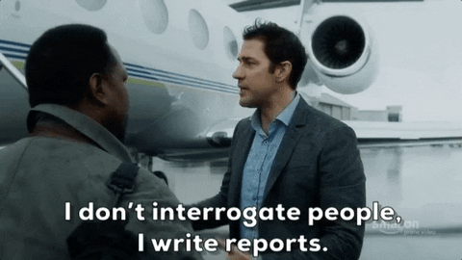

Slide 3
6.
Feasibility/Recommendation reports
Accomplishes two goals; studies the practicality of a proposed plan and then recommends action.

Slide 4
Feasibility/Recommendation reports : Why is it required?
If your company plans a project and is uncertain if its feasible
The viability of a project is determined through a feasibility report to document findings
It then recommends further course of action (recommendations)

Slide 5
Feasibility REport: Possible Scenarios
Manufacturing-Your company is considering the purchase of new equipment but is concerned that the machinery will be too expensive, the wrong size for your facilities, or incapable of performing the desired tasks.
Accounting -Your company wants to expand and is considering new locations. The decision‐makers, however, are uncertain whether the market is right for expansion. Are interest rates good? Are local property taxes and sales taxes too high? Will the city provide tax rebate incentives for your company’s growth?
Web design-Your company wants to create a Web site to market your products and services globally. The CEO wants to be sure that online checkout is easy, pricing is cost effective, products are depicted in a visually appealing way, the site is secure, and the site loads quickly. How will you make your Web site stand out

Slide 6
Feasibility/recommendation report: Criteria
Introduction (overview,background)
Discussion
Conclusion

Slide 7
Feasibility/recommendation : Criteria
Introduction (overview,background)
Objectives
Discussion
Conclusion
Personnel
subheading
subheading

Slide 8
Feasibility/recommendation: Criteria
Introduction (overview,background)
Objectives
Discussion
Conclusion
Personnel
Purpose:
1. Provide background data
2. Clear concise statement of intent

Slide 9
Feasibility/recommendation: Criteria
Introduction (overview,background)
Objectives
Discussion
Conclusion
Personnel
Purpose:
1. Provide background data
2. Clear concise statement of intent

Slide 10
Feasibility/recommendation: Criteria
What problems motivated this study?
What problems cause doubt about your the feasibility of the report (market, equipment available, is land available)
Introduction (overview,background)
Objectives
Discussion
Conclusion
Personnel

Slide 11
Feasibility/recommendation: Criteria
What problems led to the proposed project(contextualize)
Who initiated the feasibility study? (manager, supervisor…)
Introduction (overview,background)
Objectives
Discussion
Conclusion
Personnel

Slide 12
Feasibility/recommendation: Criteria
Introduction (overview,background)
Objectives
Discussion
Conclusion
Personnel
Document the names of your project team members , your liaison between your company and/or other companies
Your contacts at these other companies

Slide 13
Feasibility/recommendation: Criteria
Introduction (overview,background)
Objectives
Discussion (body, findings)
Conclusion
Personnel
Criteria:
Established to have a logical foundation for comparison of personnel, products, vendors, costs, options, schedules, and so on.

Slide 14
Feasibility/recommendation: Criteria
Introduction (overview,background)
Objectives
Discussion (body, findings)
Conclusion
Personnel
Analysis:
Compare your findings against the criteria
Use Visuals like table
Organize criteria for ease of access

Slide 15
Feasibility/recommendation: Criteria
Introduction (overview,background)
Objectives
Discussion (body, findings)
Conclusion
Personnel
Conclusion:
Significance of your findings
Draw a conclusion from findings

Slide 16
Feasibility/recommendation: Criteria
Introduction (overview,background)
Objectives
Discussion (body, findings)
Conclusion
Personnel
Recommendations:
Recommend a course of action
What should company do next?
Should it buy a piece of equipment, locate its expansion or rethink product marketability?

Slide 17
FEASIBILITY VS. Recommendation Reports
Recommendation Reports
Shortens or even skips the feasibility analysis
Includes supporting data but also affirmative position
Feasibility Reports
Uses the bottom line first approach for detailing the problem or situation, how to deal with it, the chances of successes, benefits or drawbacks, pros and cons, is the timing right
It examines predominantly whether the approach will work (“Should we do it?”

Slide 18
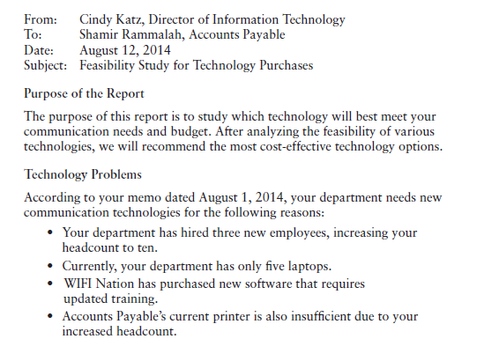

Slide 19
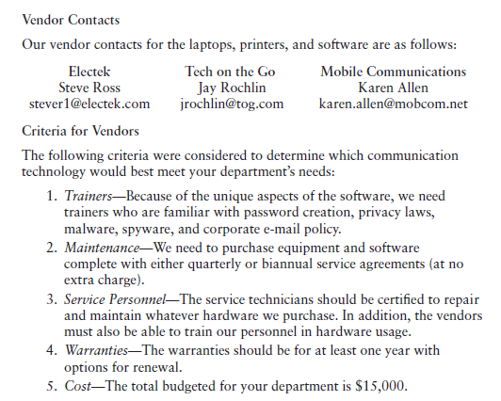

Slide 20
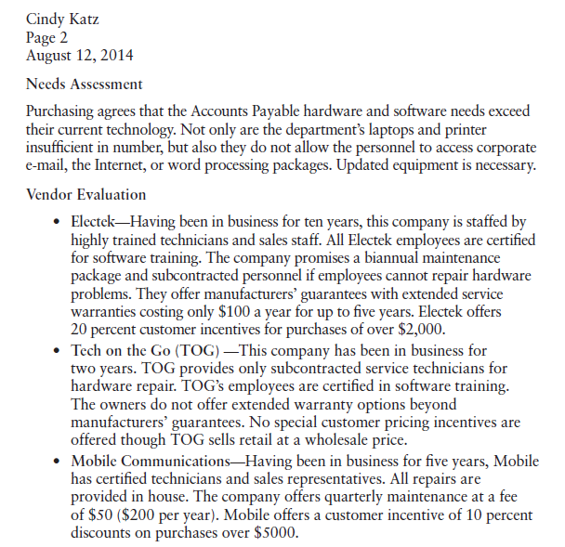

Slide 21
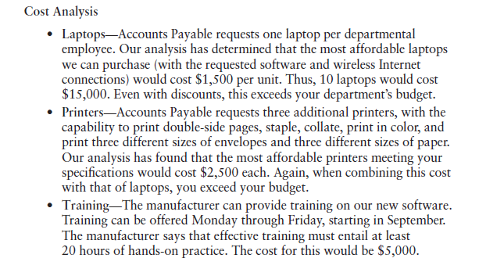

Slide 22
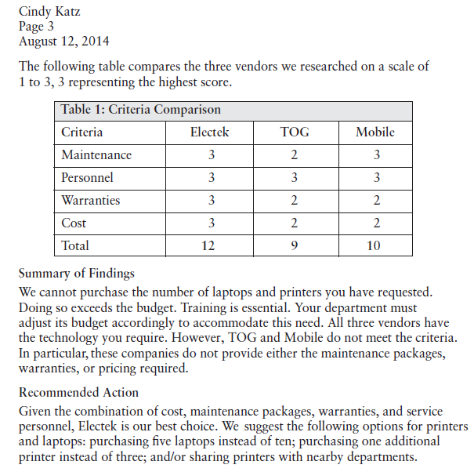

Slide 23

Activity 1
The employees of AB Tech Firm have been experiencing issues like backache, headache, eyestrain, double and blurred vision and stiff joints. This has decreased the productivity and efficiency of the employees and raised a concern with the team lead who is compiling a feasibility report which details the plan for resolving the issues and the practicality of the recommended solutions to the problems while also discussing any alternatives. The solutions proposed should be practical given the size of the employee, however, it should not be less than 50 employees. Once formulated, the team lead would be sharing the feasibility report with the supervisor who will then share it with the higher executives for approval.

Slide 24
Activity 2
Incident Report
Write a report to the director of the campus on a disciplinary issue that took place on campus premises. Make sure you add separately plan the following before drafting the report:
Details about the person reporting the information
Details about the incident
Description of activity that led up to and took place within the incident
Details of people involved (and affected)
Testimonials (Details of Witness)
Additional Reporting

Slide 25
Any questions?

